Slide 1

HALL TICKET GENERATOR USING QR CODE
MAJOR PROJECT
SUBMITTED BY:
SOUMO DHALI - 434122010014
IVYLATA DAS - 434122020017
UNDER GUIDENCE OF:
PROF. RUPA SAHA
NARULA INSTITUTE OF TECHNOLOGY

Slide 2
ACKNOWLEDGEMENT:
We would like to express our sincere gratitude to our Project Coordinator‘ PROF. DEBRUPA PAL and our mentor PROF. RUPA SAHA other faculty of Computer Application department of Narula Institute of Technology for their exceptional guidance and support throughout the project. Their dedication, expertise, and commitment have been instrumental in ensuring the success of our project. We are truly grateful for their valuable insights and unwavering support, which have helped us achieve our goals. Thank you for being an invaluable part of our team.

Slide 3
TABLE OF CONTENT
1
2
3
INTRODUCTION
PURPOSE
SCOPE
4
5
6
SYSTEM DESIGN
APPLICATION
CONCLUSION

Slide 4
Introduction

Slide 5
Introduction:
The Hall Ticket Generator with QR Code Integration is a project aimed at revolutionizing the way hall tickets are issued and managed for various examinations, because the traditional method of issuing paper based hall tickets is not only cumbersome but also prone to errors and misuse.

Slide 6
This project will involve the development of a web-based application that allows examination authorities to generate and issue hall tickets with unique QR codes for each student. The application will also include features for managing examination schedules, seating arrangements, and generating reports.

Slide 7
Purpose:

Slide 8
Purpose:
The Hall Ticket Generator with QR Code Integration project modernizes the issuance and management of hall tickets for examinations.
Allows examination authorities to generate and issue hall tickets with unique QR codes for each student.
Using QR codes, the project enhances security, reduces fraud, and improves efficiency.

Slide 9
Scope:
The Hall Ticket Generator with QR Code Integration application offers a wide range of benefits and opportunities for improvement in the examination process. Some of the key scopes of this application include:

Slide 10
Scope:
Enhanced Security: By integrating QR codes into hall tickets, the application ensures that only authentic hall tickets are accepted
Efficiency: The application streamlines the process of issuing and managing hall tickets
Cost-Effectiveness : By reducing the need for paper-based hall tickets and manual verification processes, the application helps in saving costs for examination authorities

Slide 11
System Design:

Slide 12
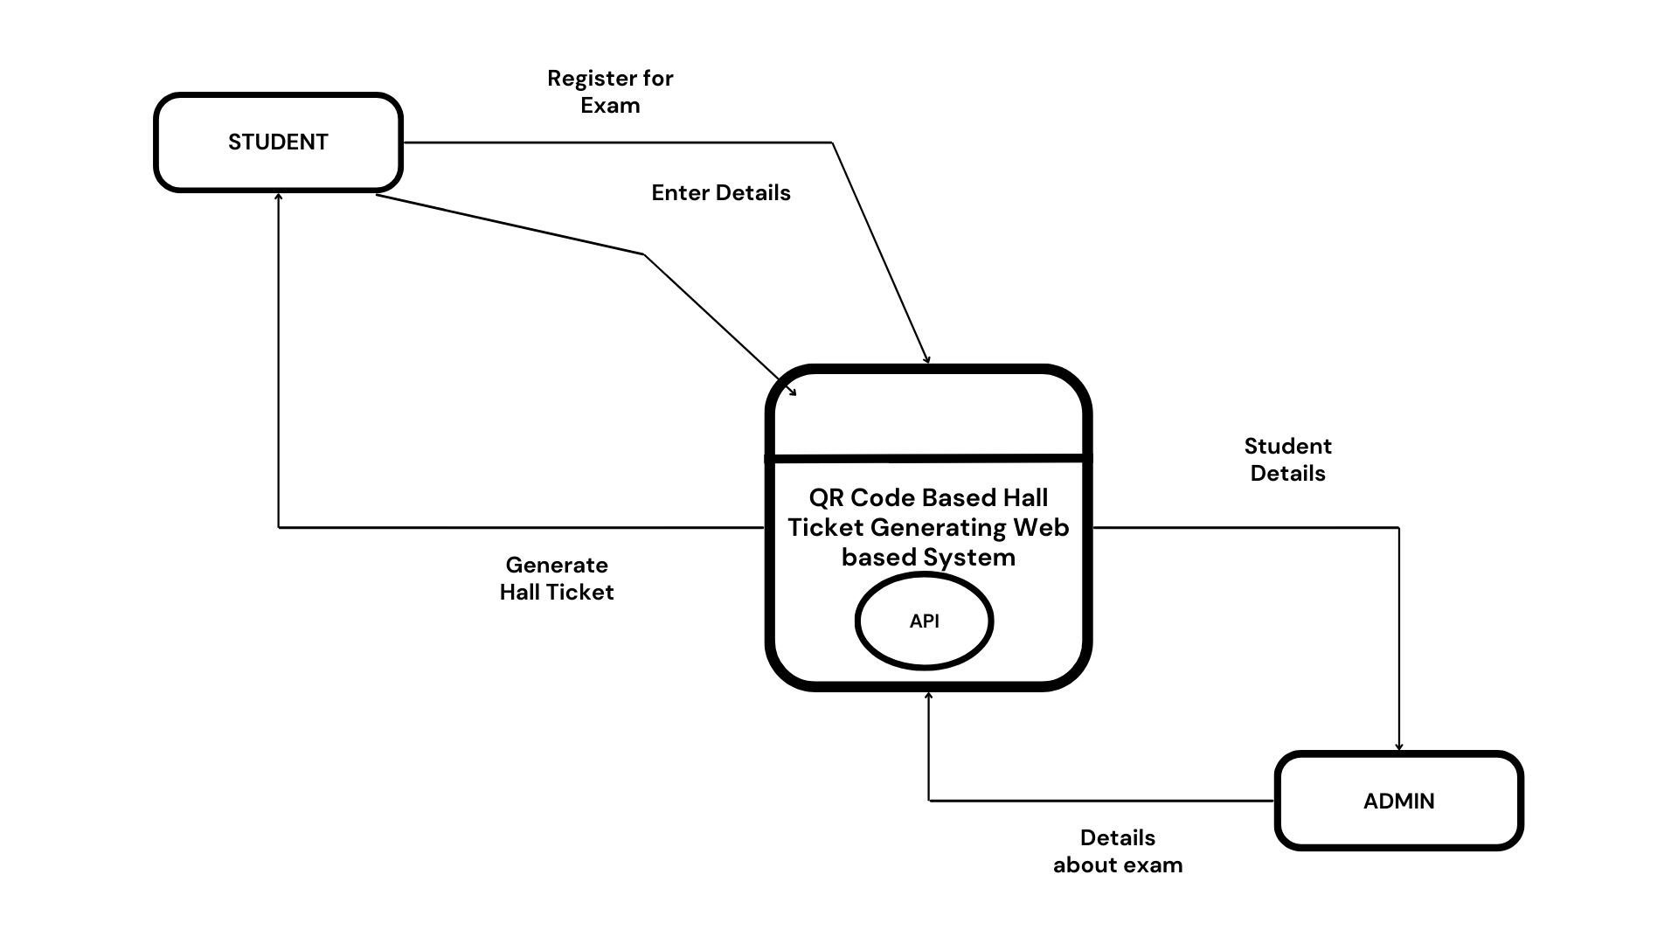
System Design
Context.

Slide 13
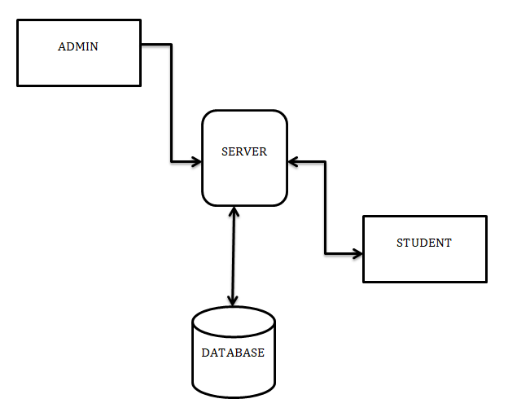
System Design
DFD-Lv.1

Slide 14
Application:
And Result

Slide 15
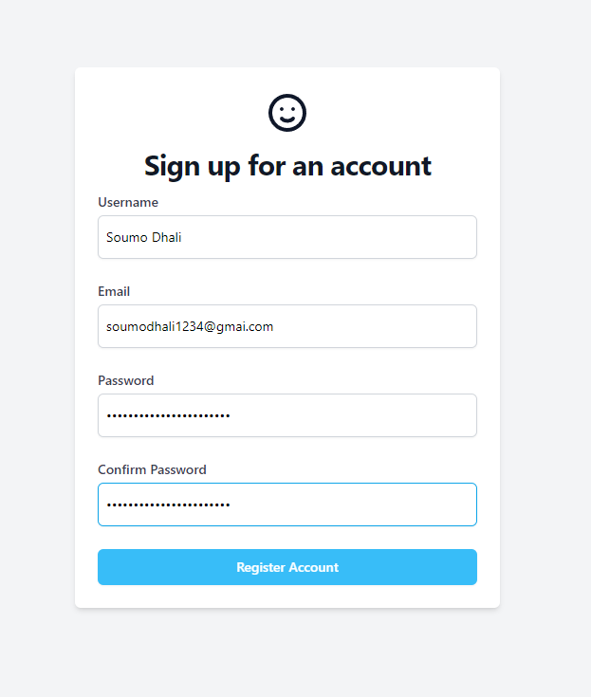
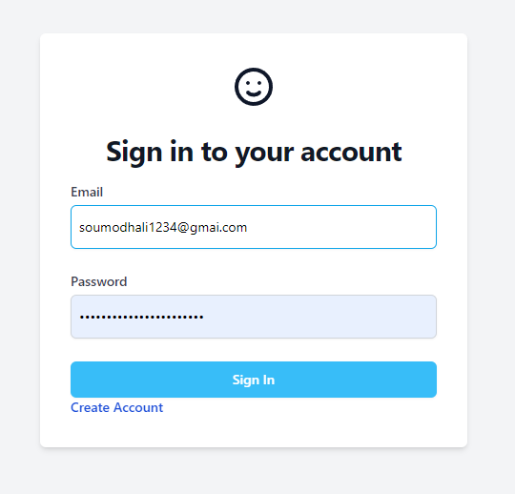
Sign up forum
Sign in forum

Slide 16
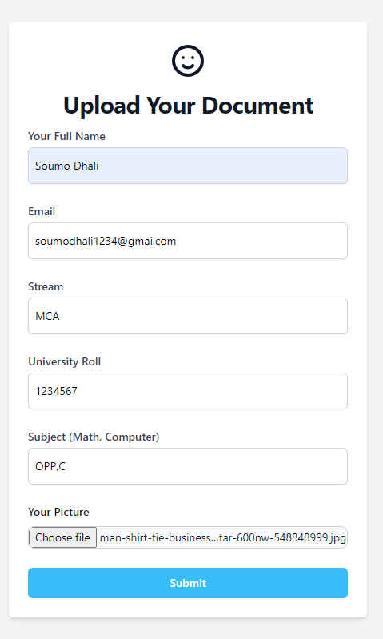
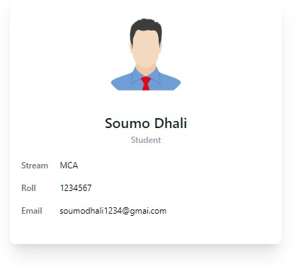
Doc upload forum
Generated Student Card

Slide 17
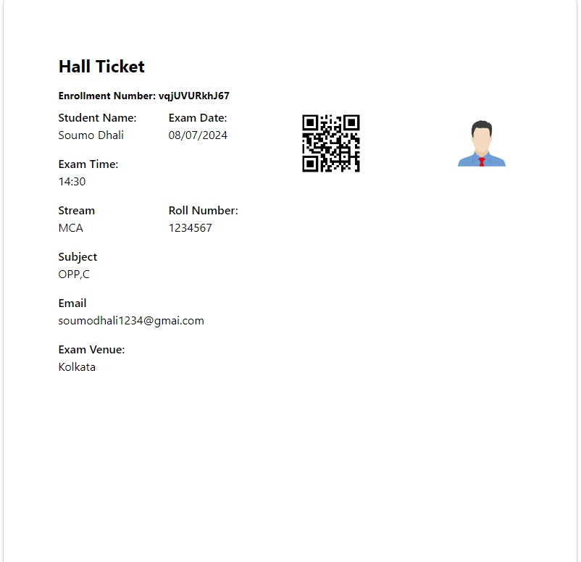
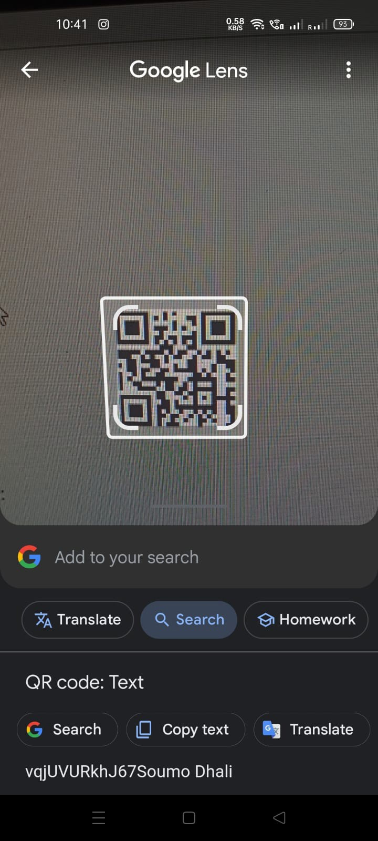
Result
Hall Ticket with QR code

Slide 18
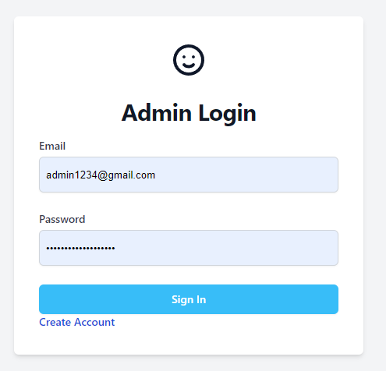
Admin Login forum and Details Access section:

Slide 19
Conclusion:

Slide 20
Conclusion:
In conclusion, the Hall Ticket Generator using QR Code project showcases the power of technology to improve administrative processes in education, setting a new standard for efficiency and security in examination management.

Slide 21
GITHUB REPOSITORY LINK:
https://github.com/Ivylata/majorProject

Slide 22
Thank You

